Slide 1
Ensembling northern rock soles
Alaska Fisheries
Science Center

Slide 2
Northern rock sole models
Base model
Survey catchability with informative prior (mean=1.5, CV=5%)
M fixed at 0.15 for both sexes
Estimate Male M
Female fixed at 0.15
Estimate Male M and survey catchability
Other models examined but excluded from consideration:
As base but estimate M, same for both sexes
As base but q estimated
Estimate both male and female M

Slide 3
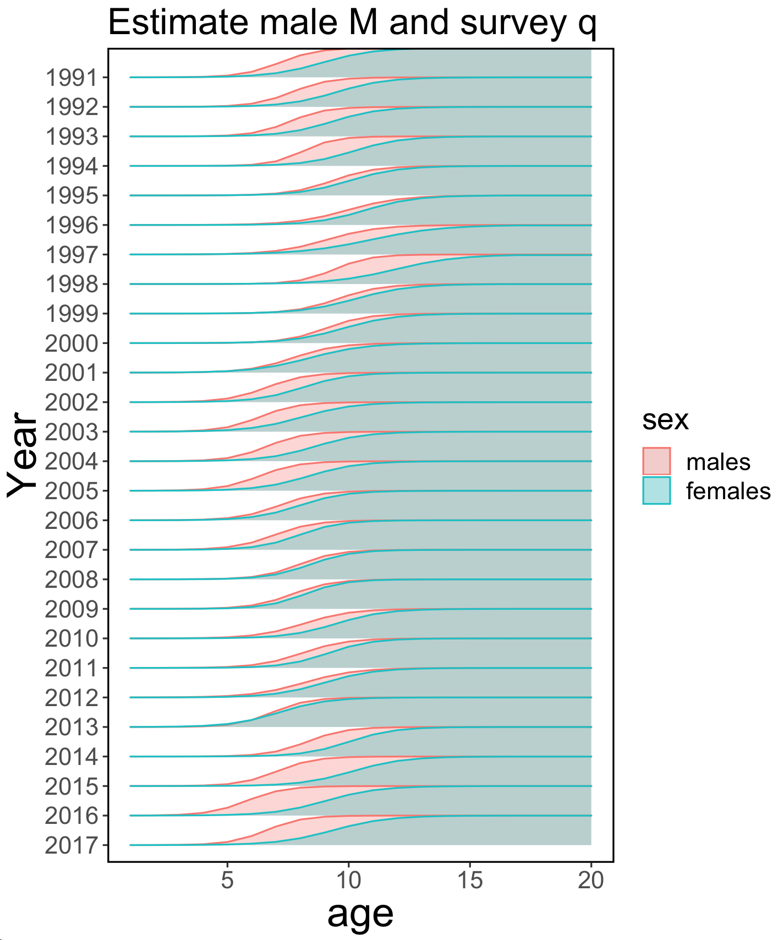
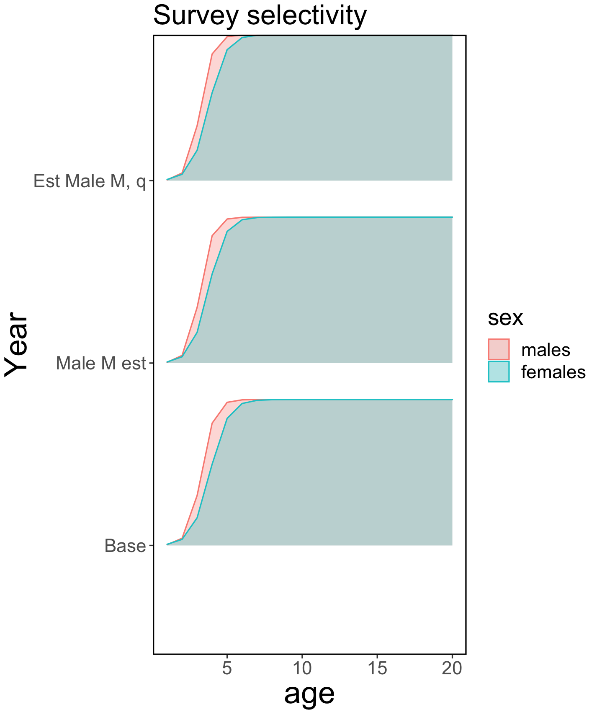
Selectivity
Fishery

Slide 4
How to find support for ensemble subset
Examine relative lack of fit…

Slide 5
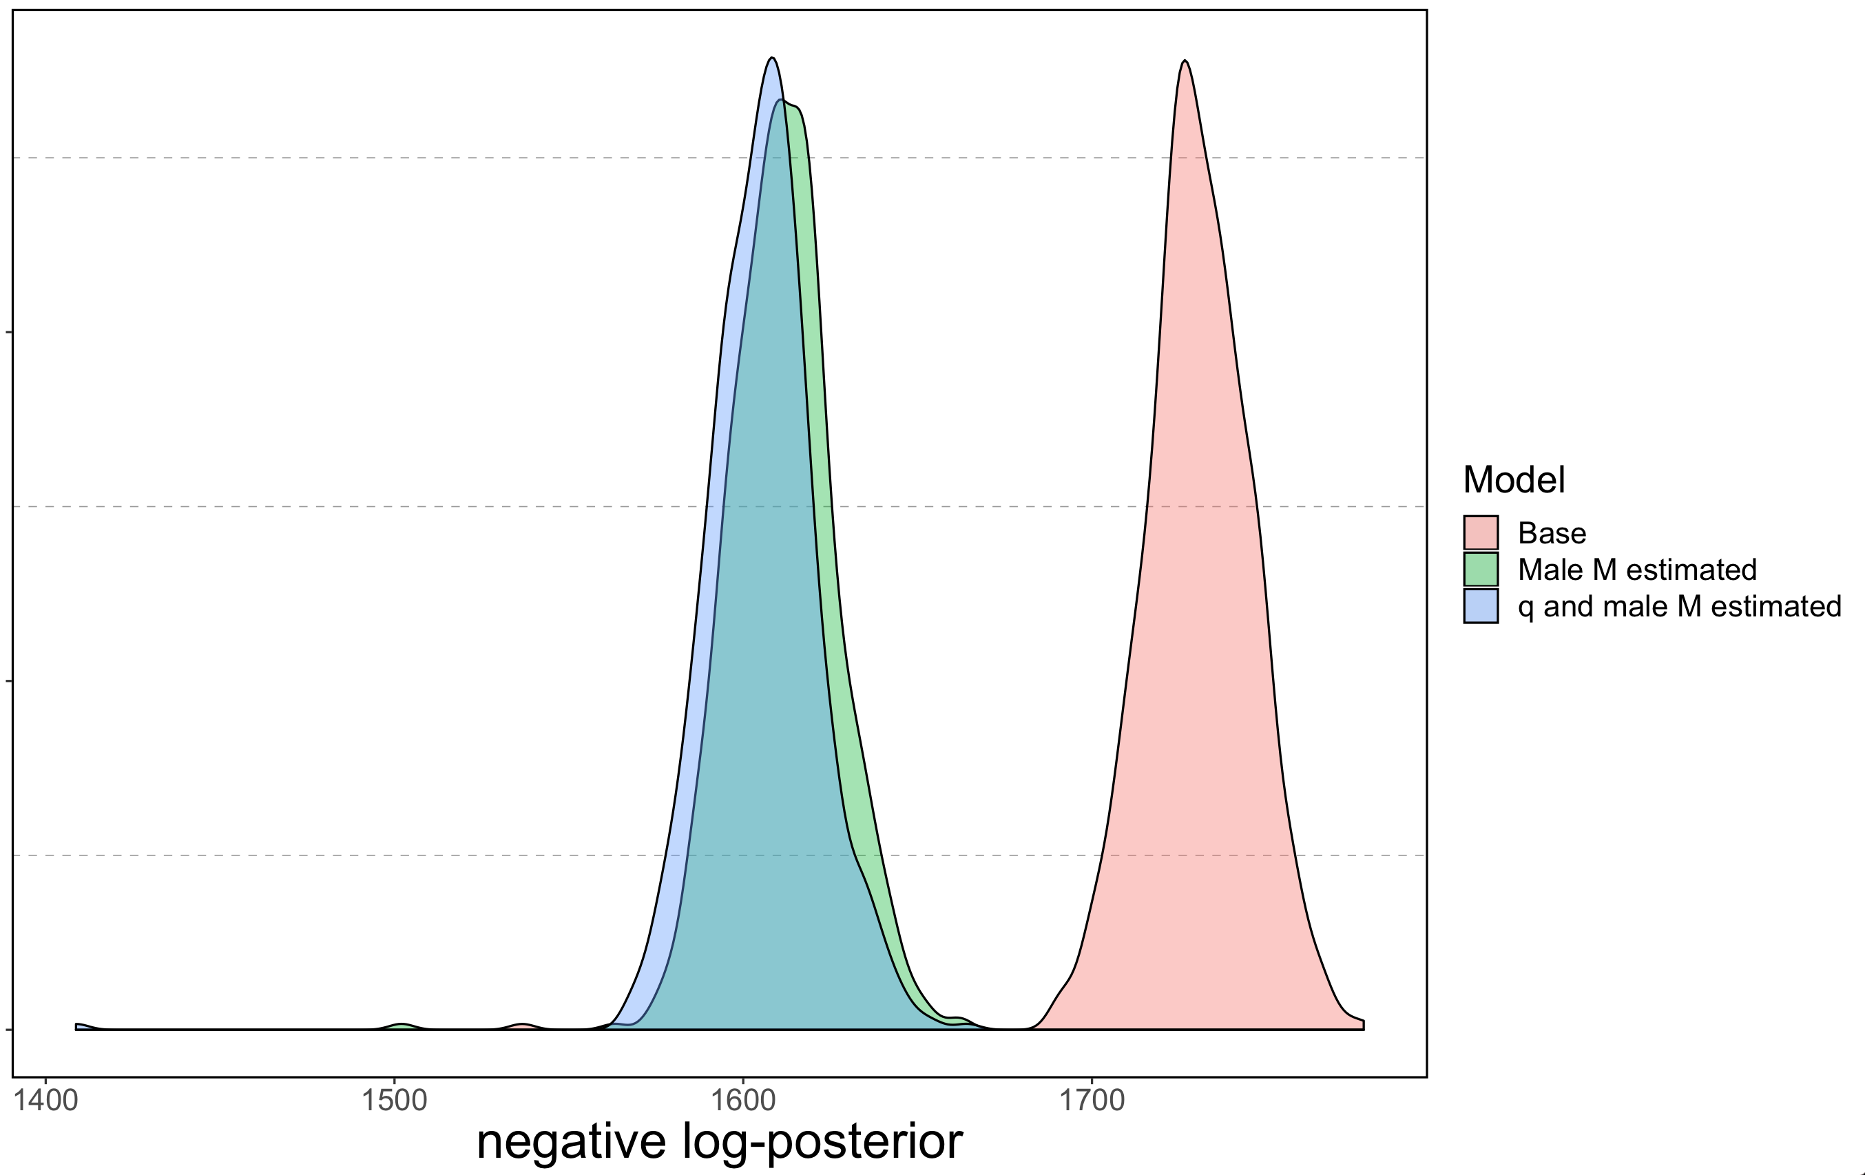
Judging fits (lower is better)

Slide 6
Indications?
Sex-specific M fit data better…
But where/which data?

Slide 7
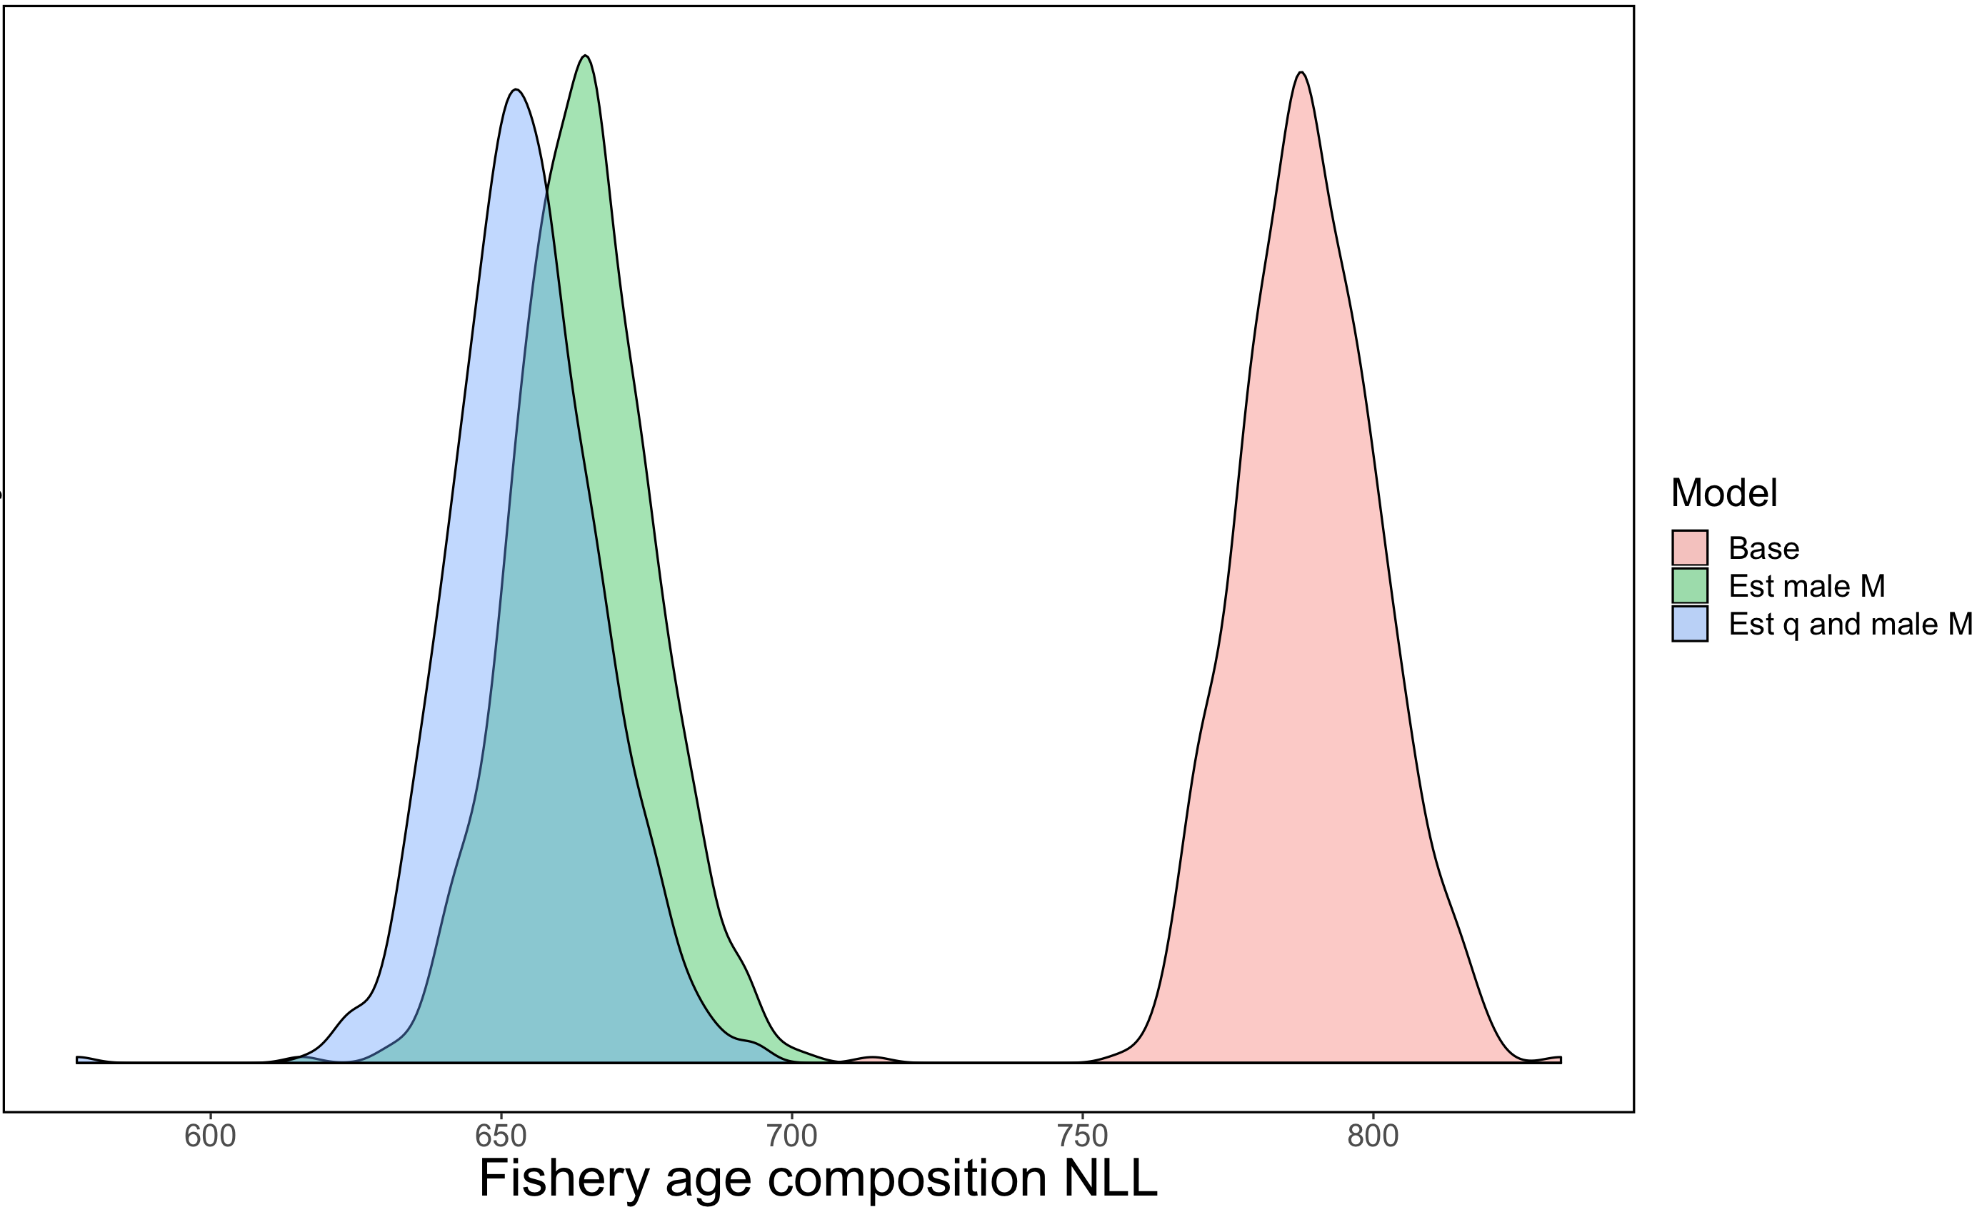
Fishery age composition (lower better)

Slide 8
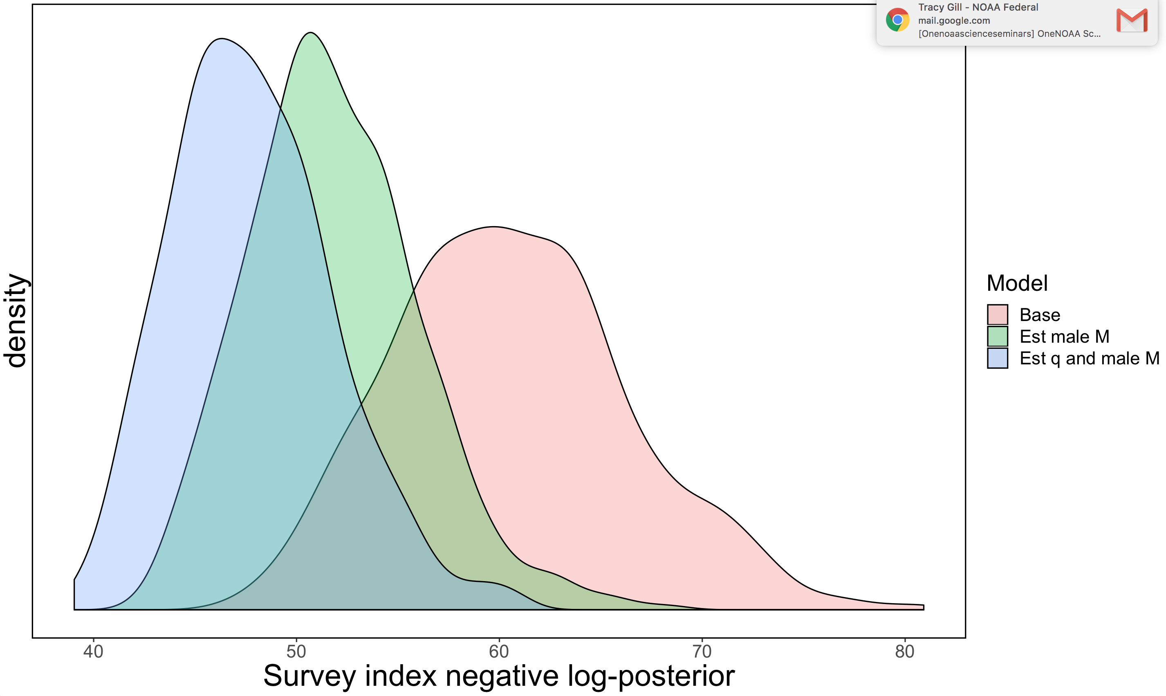
Survey index (lower better)

Slide 9
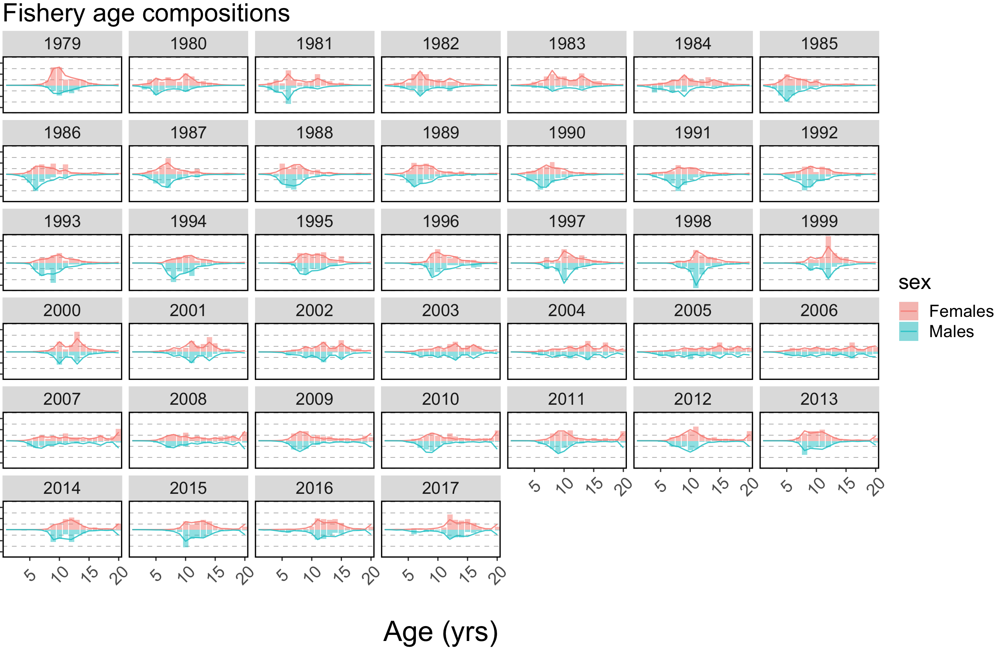
Female = male M = 0.15

Slide 10

Estimated male M

Slide 11
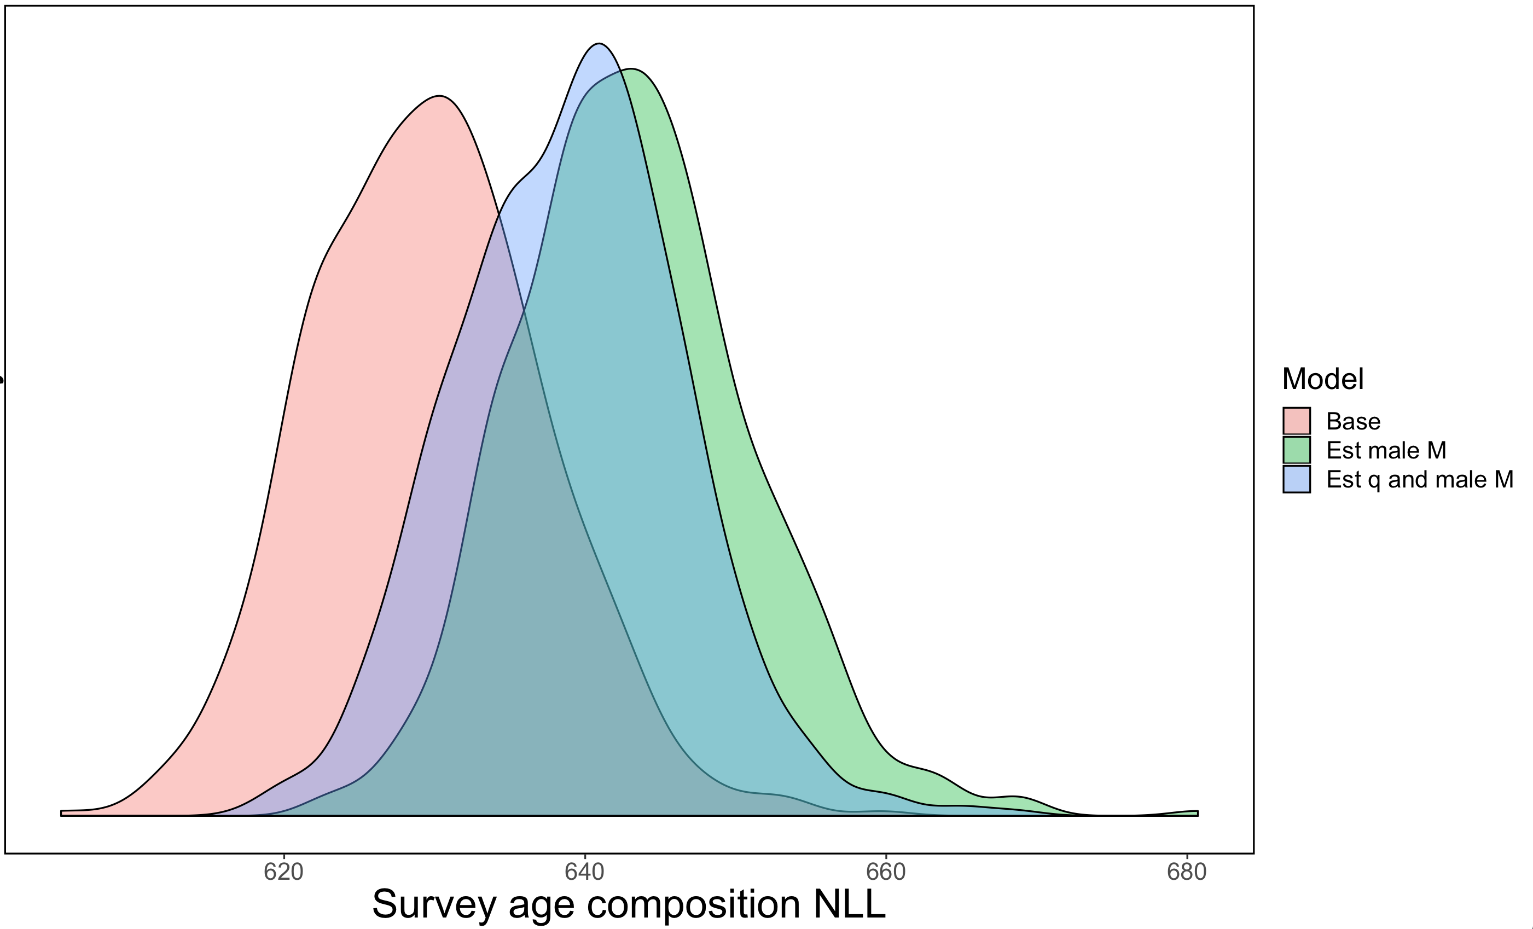
Survey age compositions (base wins!)

Slide 12
So…why survey sex ratio different?

Slide 13
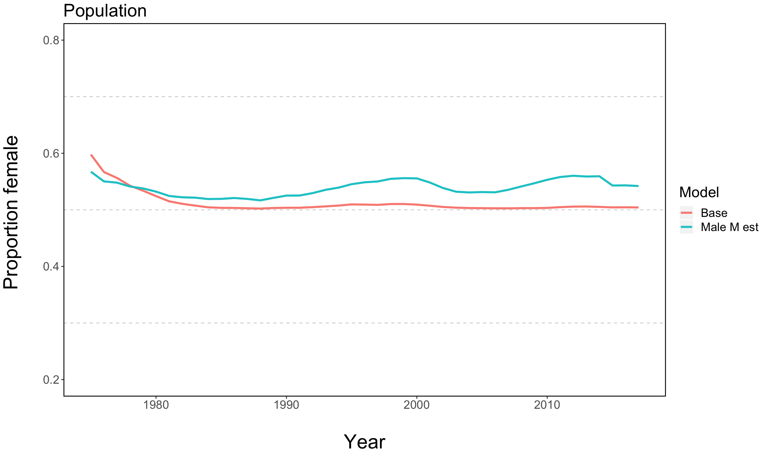
Estimated population sex ratio

Slide 14
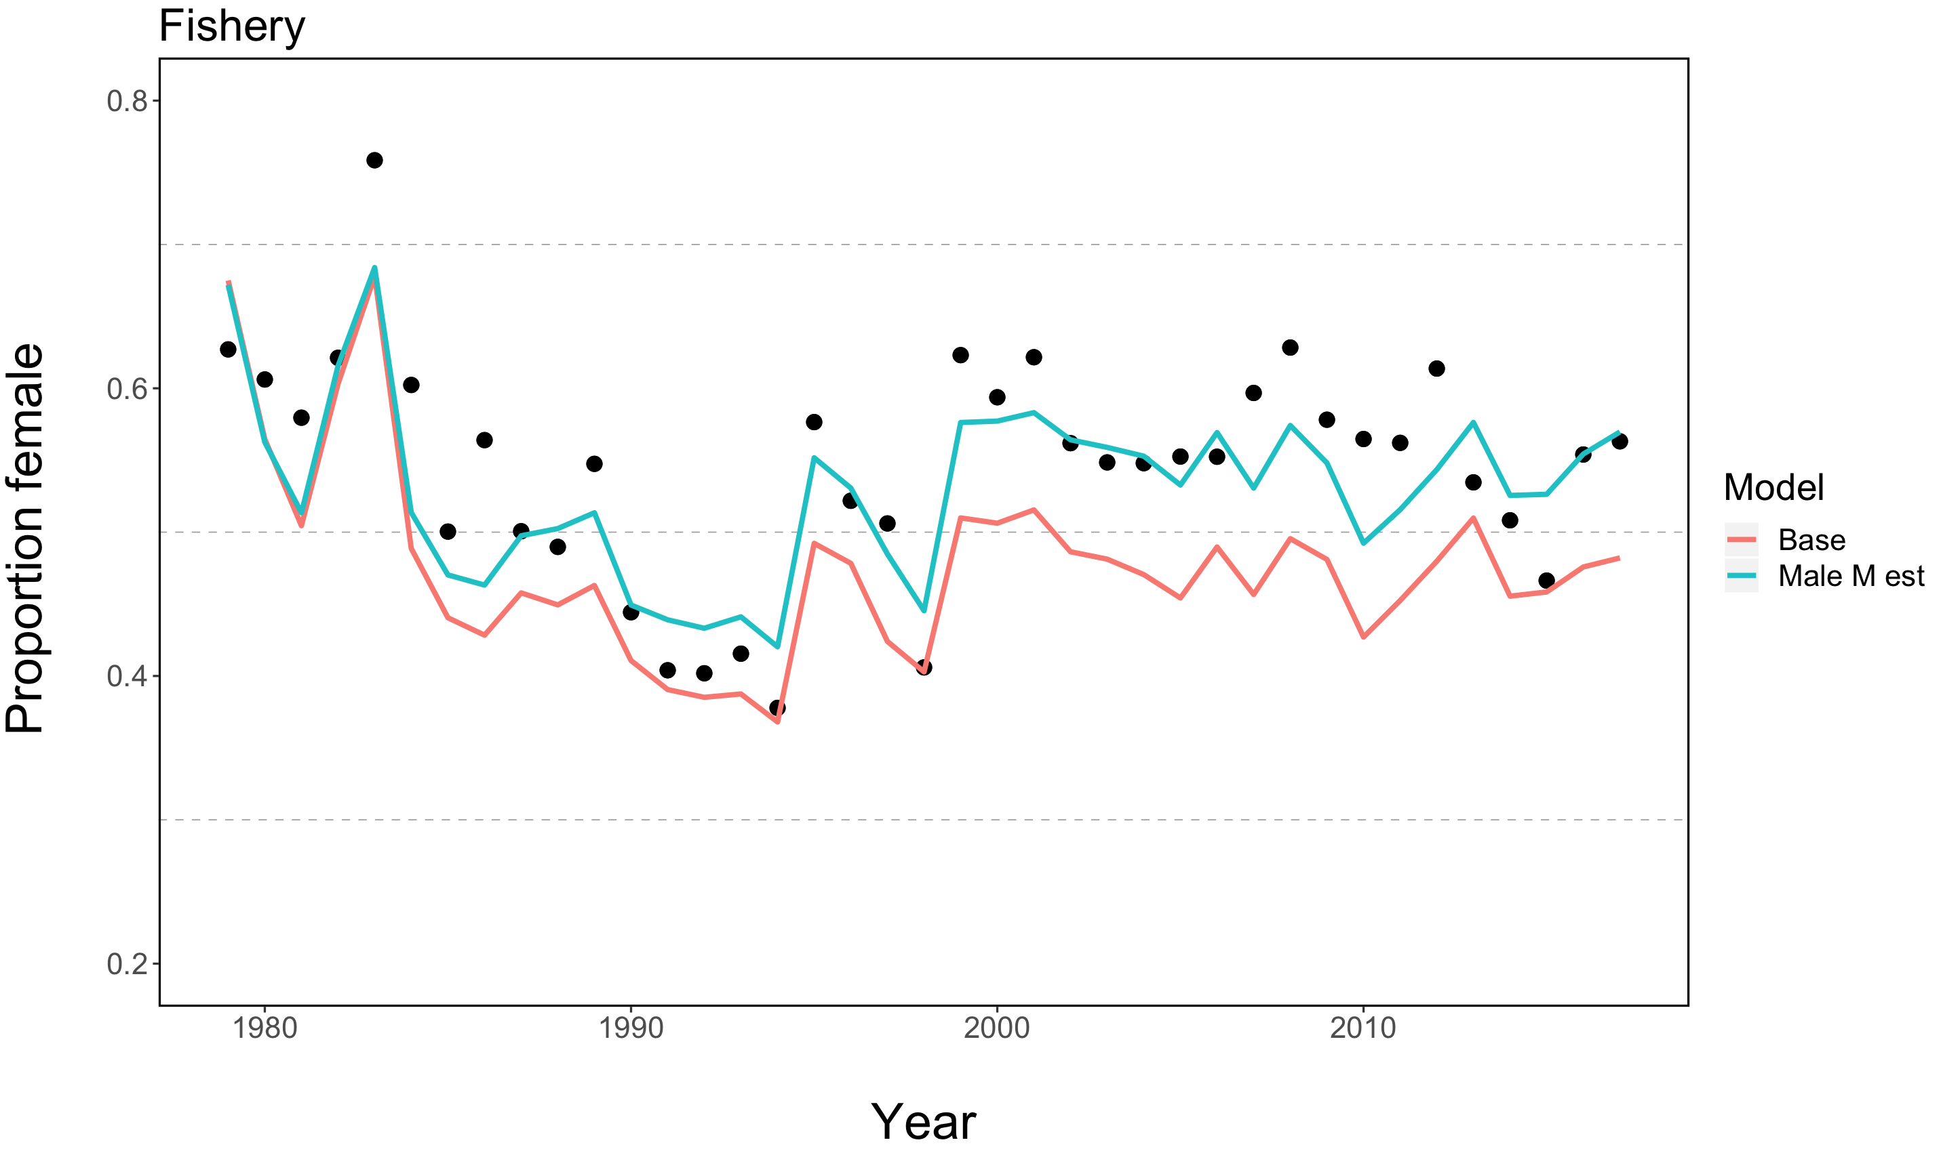

Slide 15
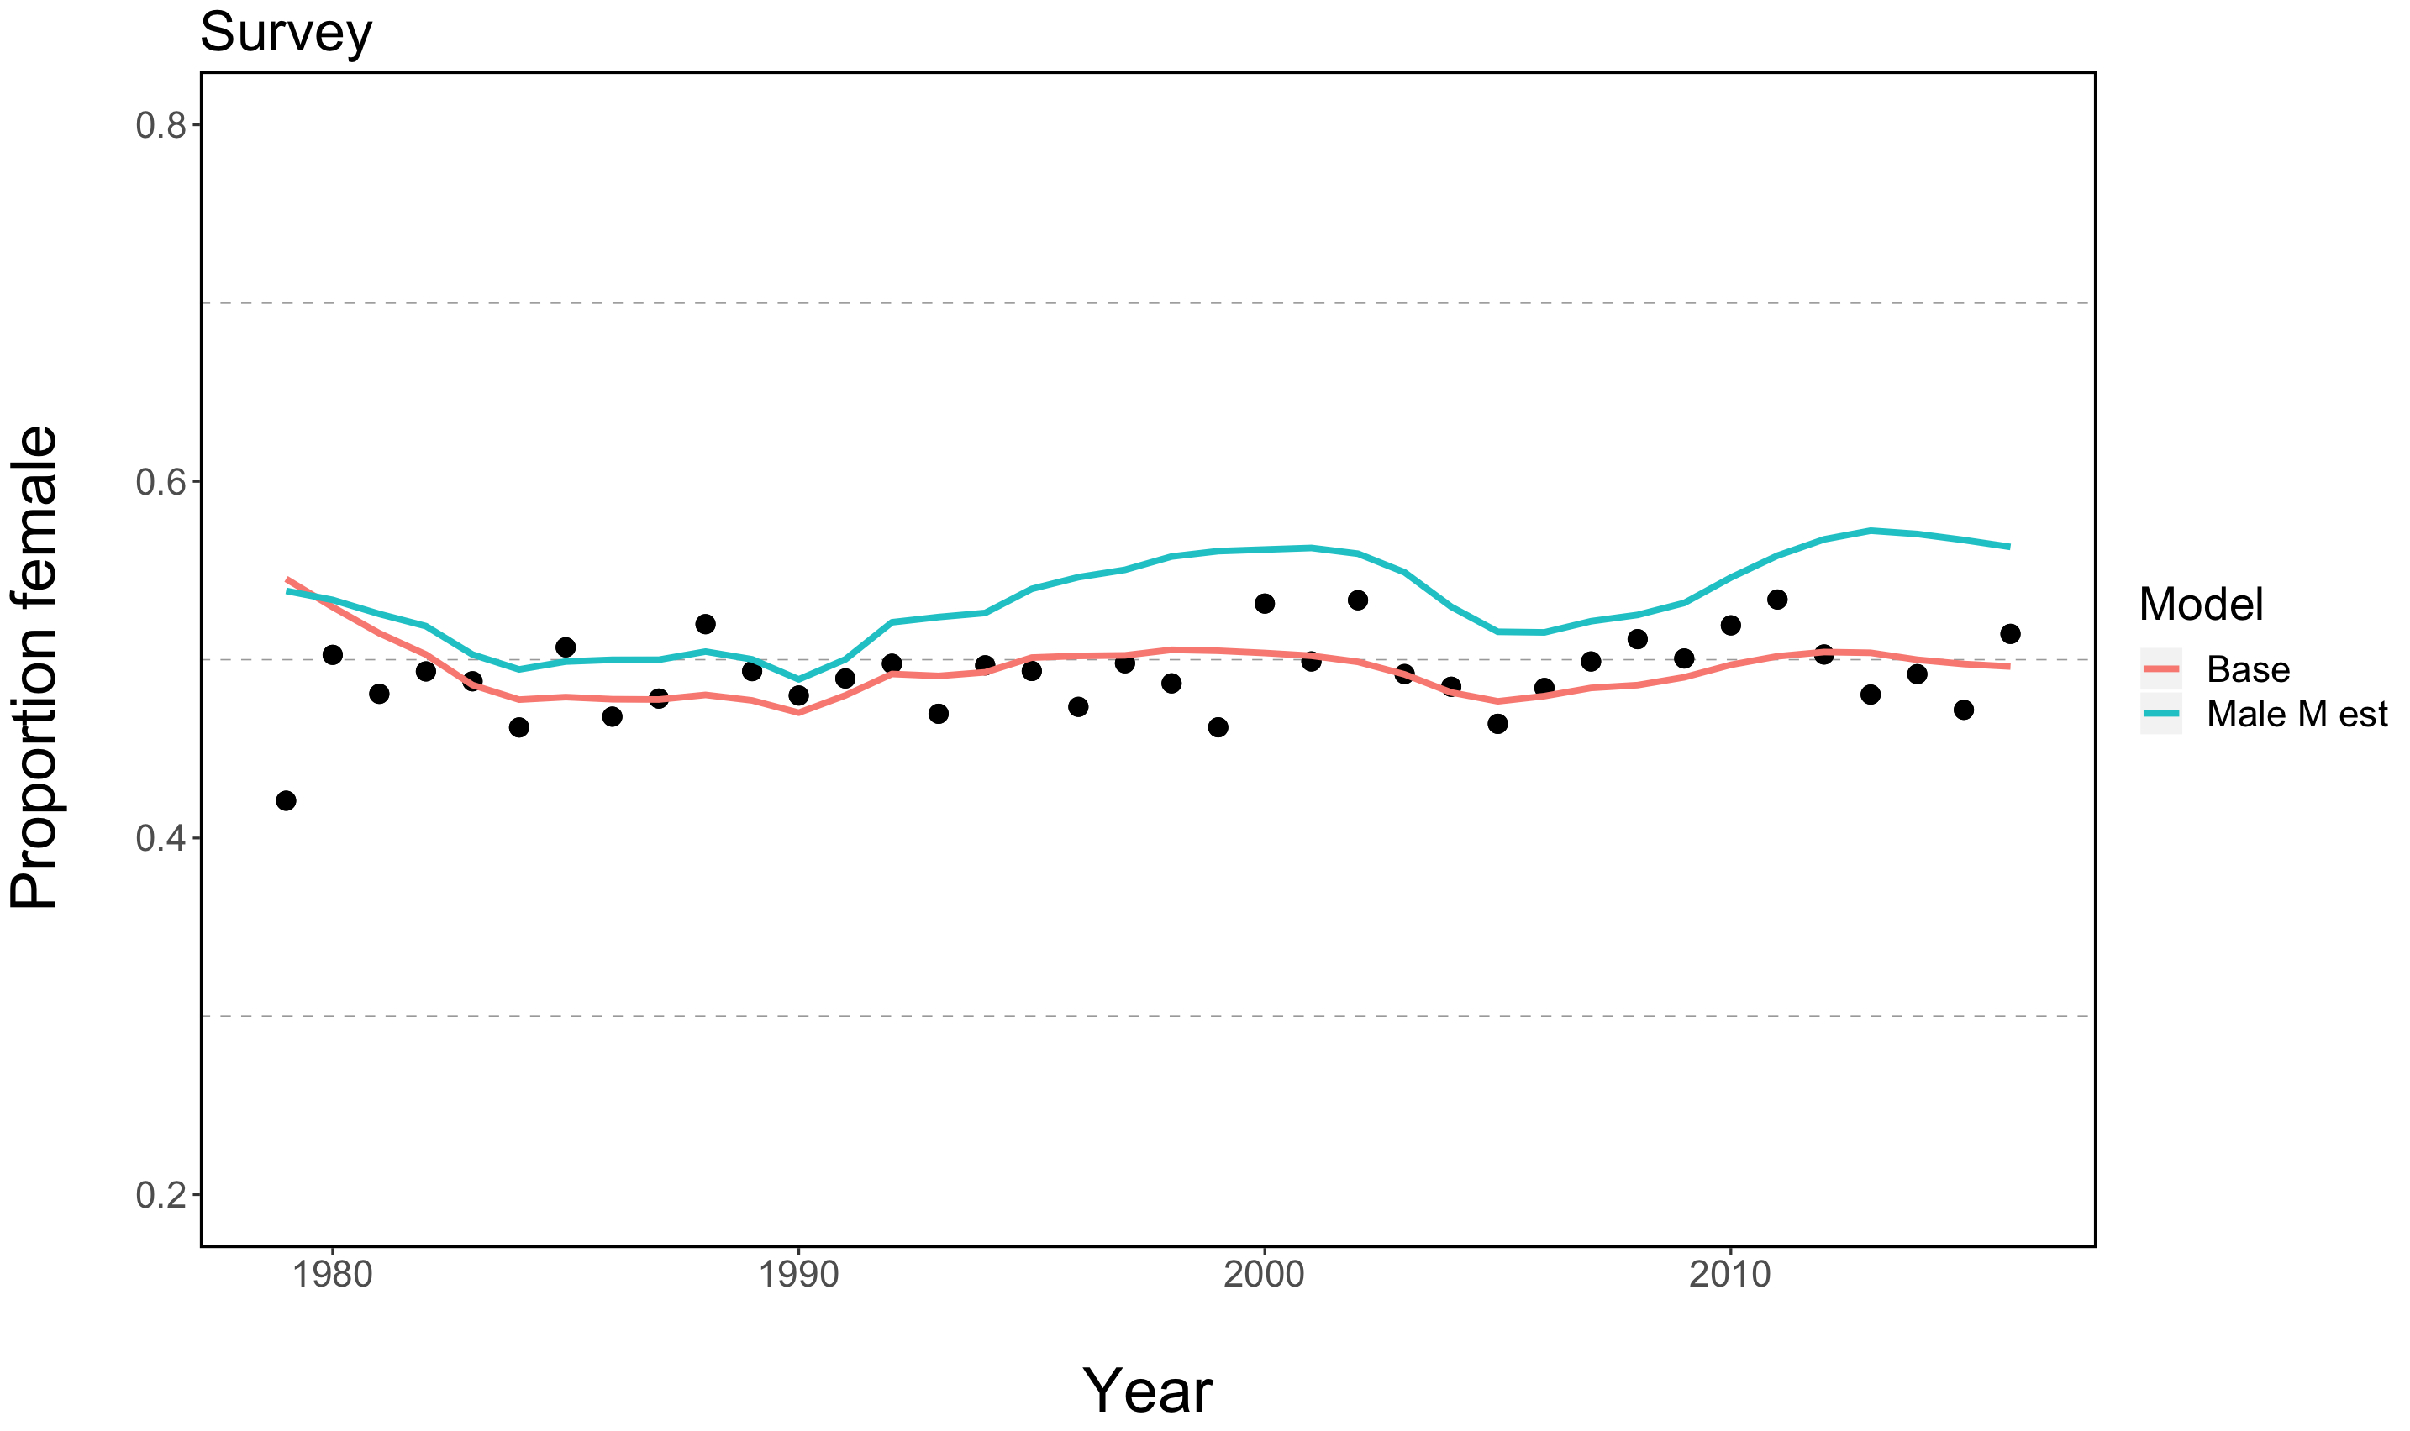

Slide 16
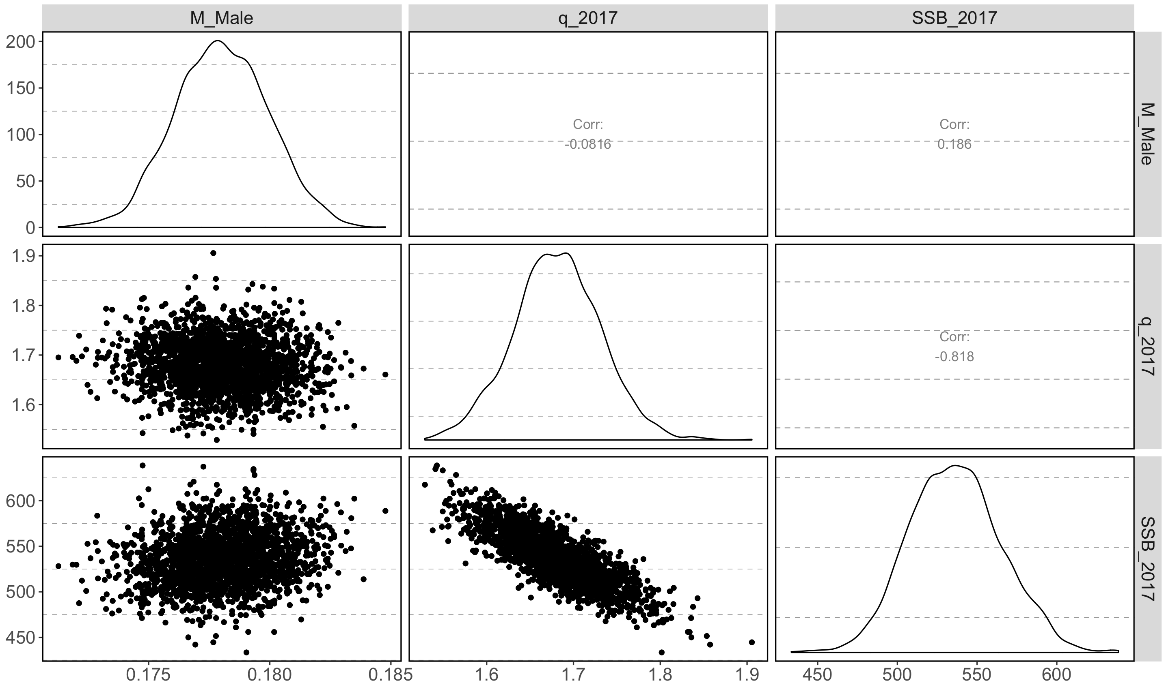
Q vs M? –Male M estimated

Slide 17
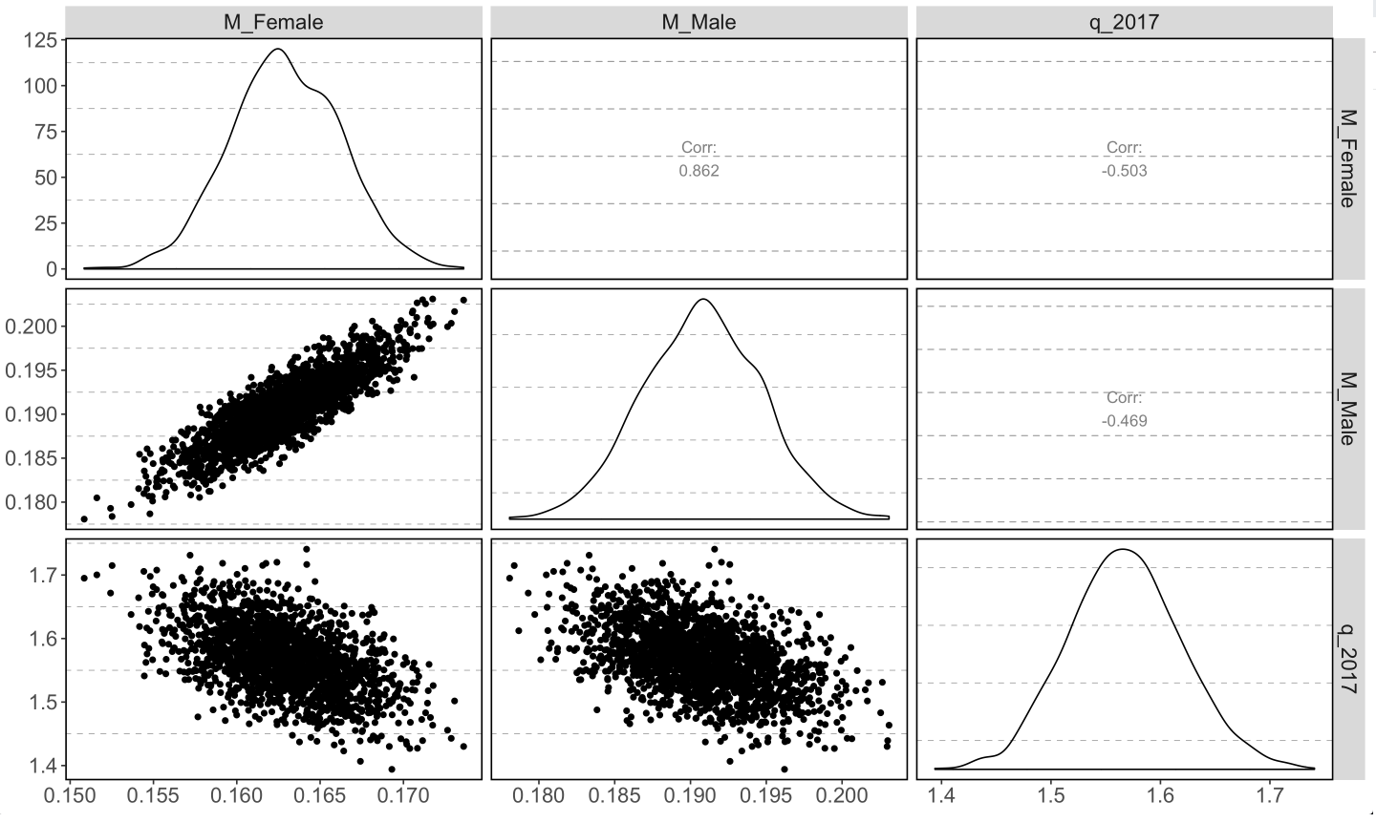
Q vs M? Male and Female M estimated

Slide 18
Back to ensembling…

Slide 19
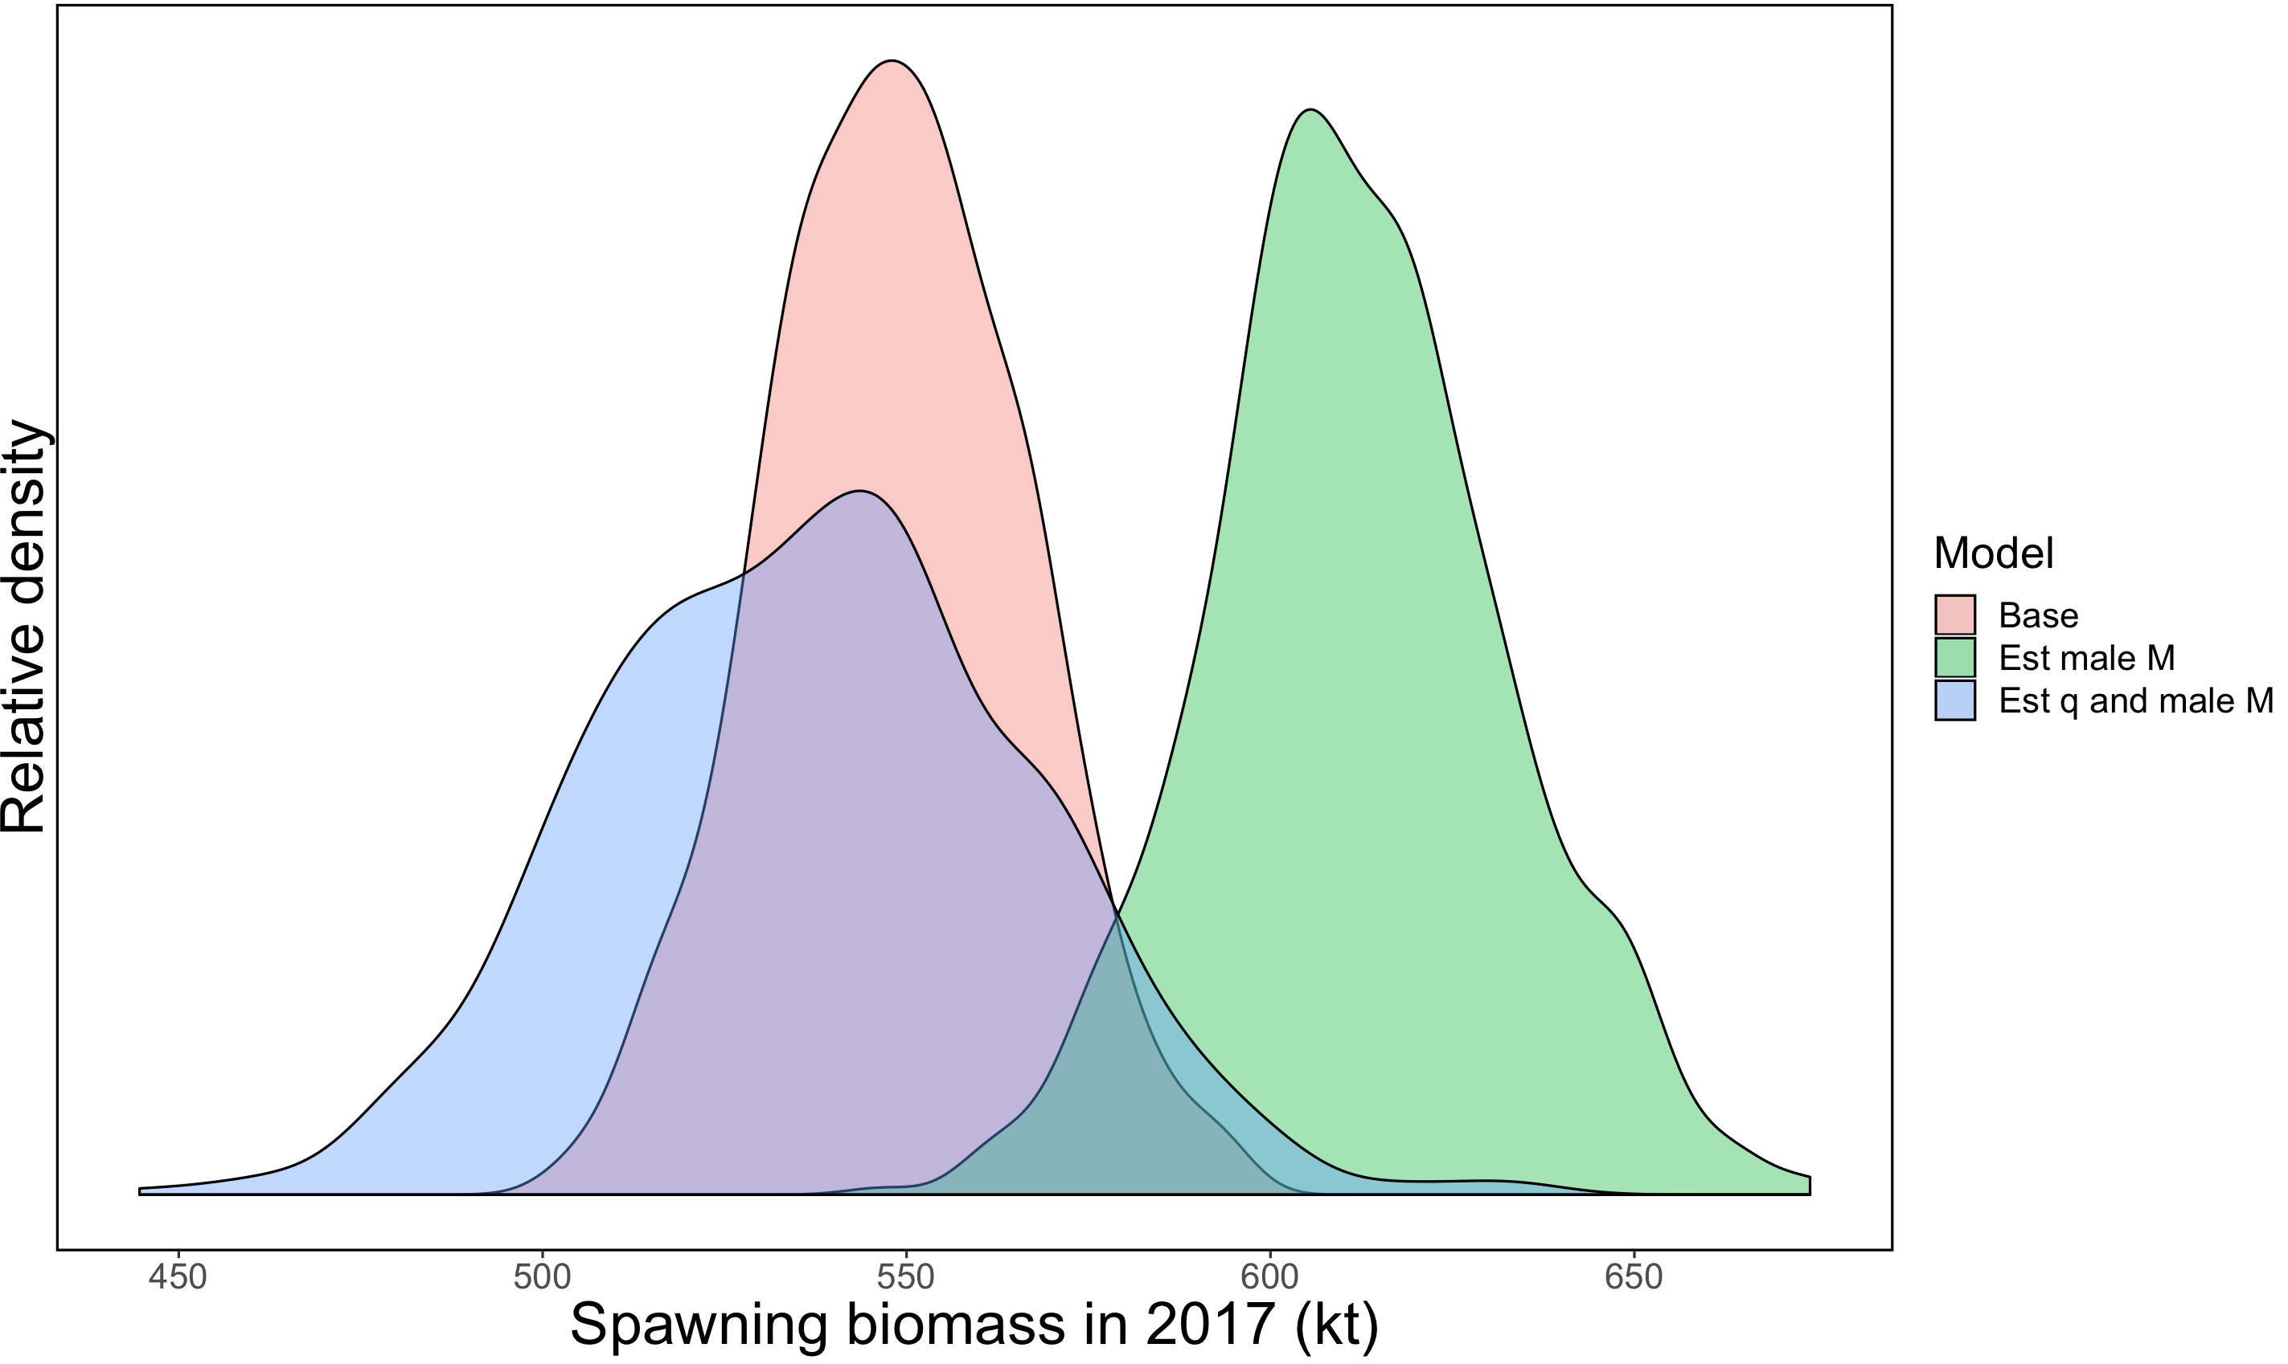
Female spawning biomass (kt)

Slide 20
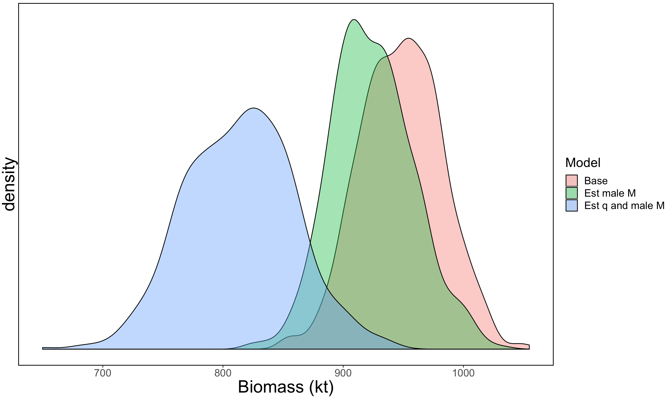
Biomass of 7+ N. rock sole

Slide 21
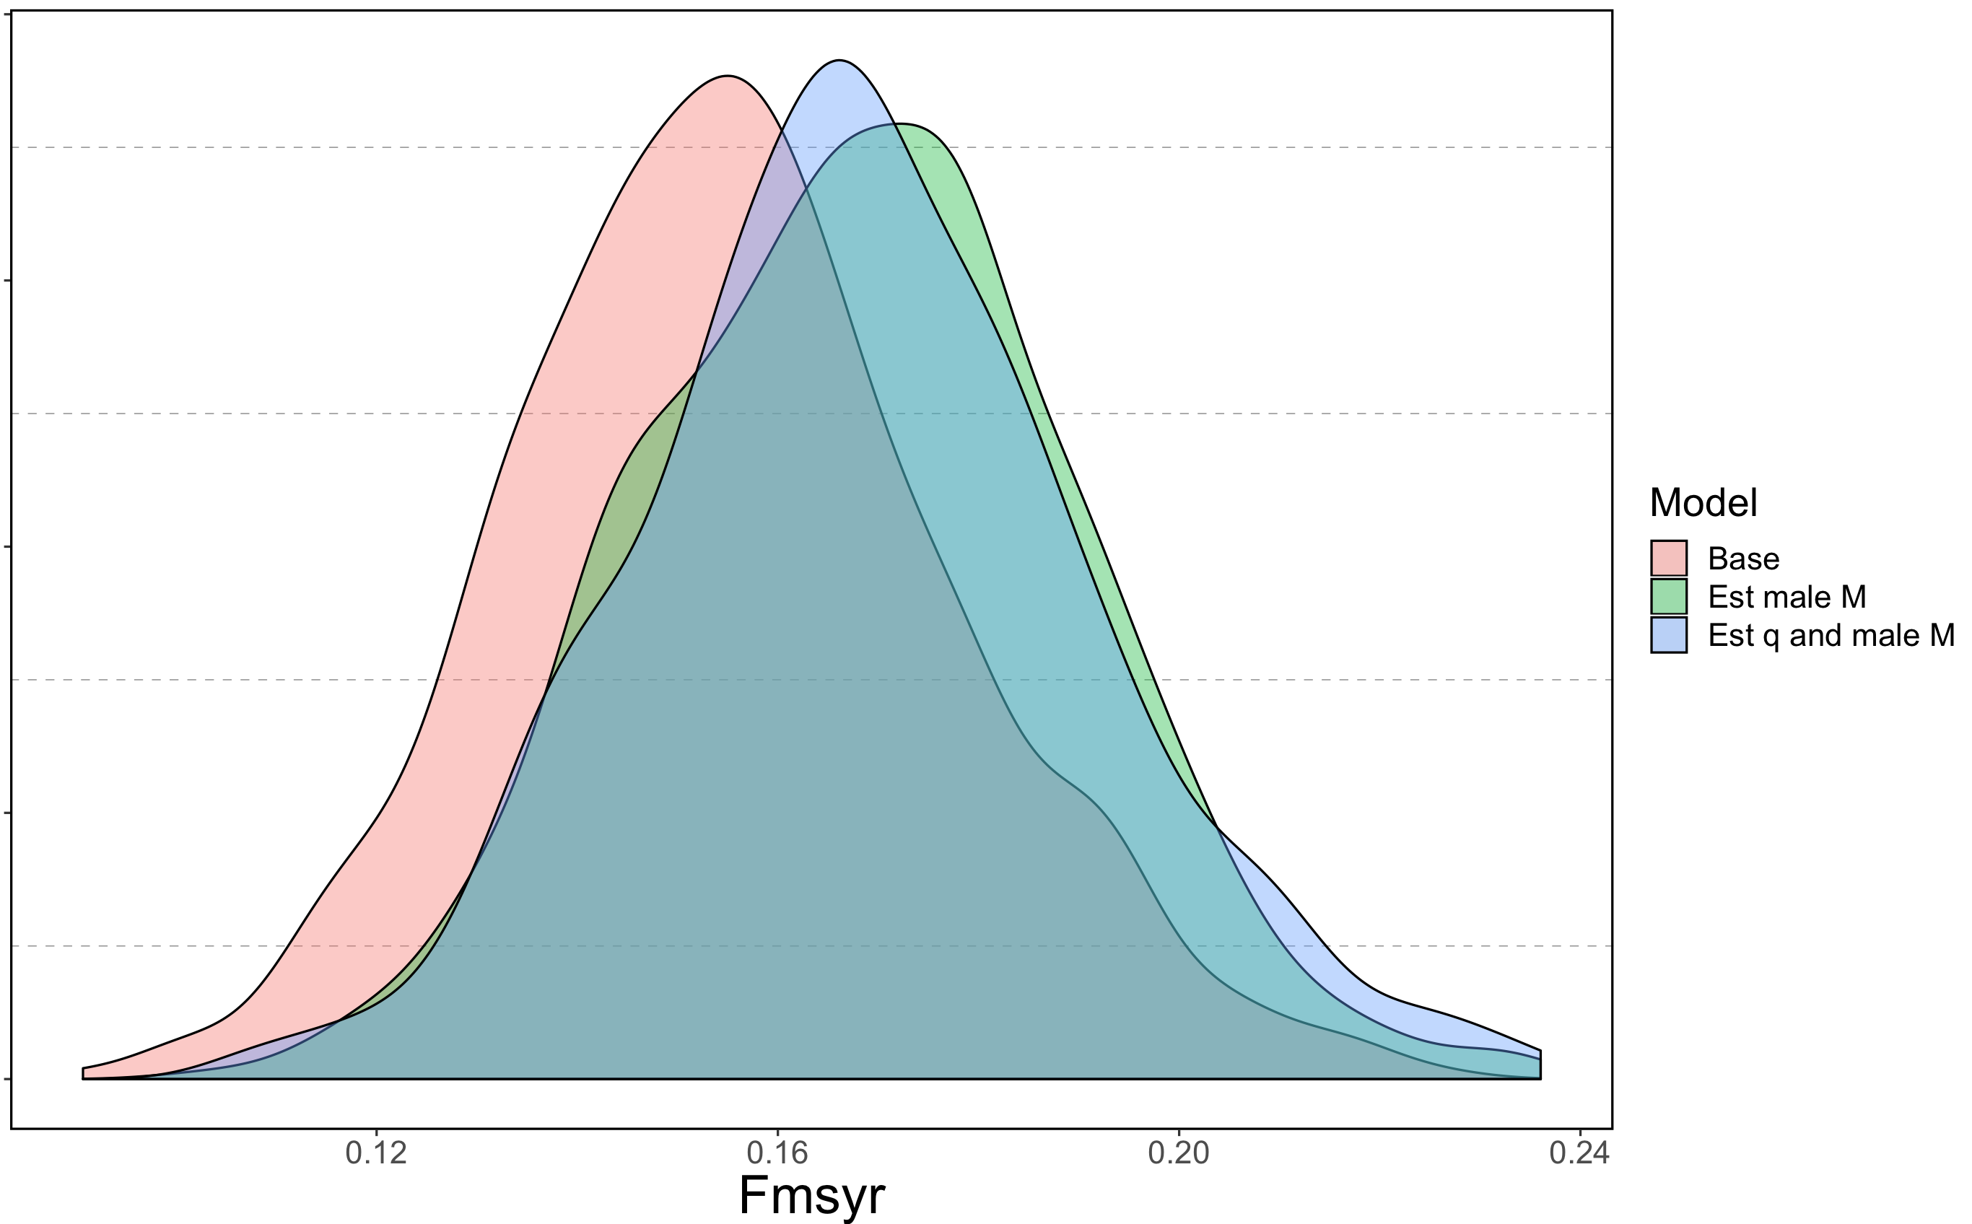

Slide 22
ABC calculation review
Present day:
Based on analytical formulae and Delta method estimate of variance
Alternative
Use MCMC posterior estimate
Can facilitate

Slide 23
Do buffers change?

Slide 24
ABCs from MCMC individual models (and combined)
 | FOFL | FABC | Biomass | ABC | OFL | Buffer
Base | 0.156 | 0.152 | 948 | 144 | 147 | 2.1%
Estimate Male M | 0.169 | 0.166 | 924 | 153 | 156 | 1.7%
Estimate Male M, q | 0.169 | 0.166 | 812 | 135 | 137 | 1.9%
“Stacked” ensemble | 0.164 | 0.161 | 893 | 143 | 147 | 2.3%
Mean point estimates | 0.165 | 0.161 | 895 | 144 | 147 | 1.8%

Slide 25
Conclusions/questions
Some of the guidance provided from ensemble meeting was followed
Considering models to include
Rationale for weights (equal)
Evaluating an ensemble versus a single model
Easing the calculations
MCMCs pretty easy
Depart from analytical form used now, but may need more MCMC diagnostics

